Slide 1
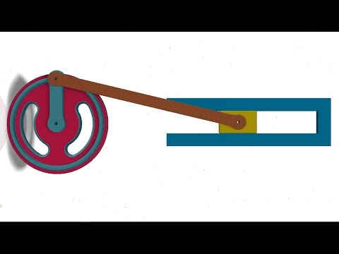
Slider Crank Mechanism :

Slide 2
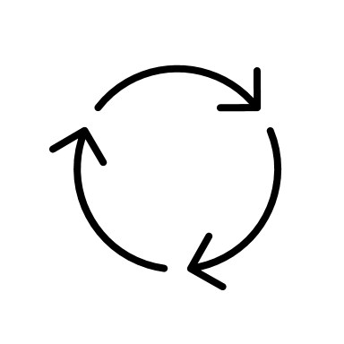
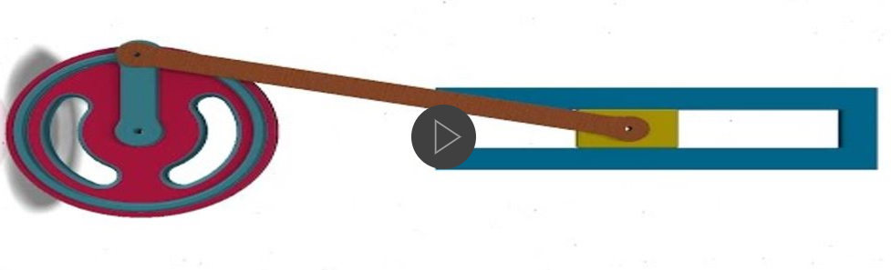
Locus of point or Loci of point (P):
It is a point which is used for traced out the path while moving in a plane, according to some given condition. These are the set of points that meet a given condition.
Slider crank mechanism :
A slider crank mechanism is used to transform rotational motion into translation motion by means of a rotating drving beam, connecting rod and a sliding body.
A slider crank mechanism converts circular motion of crank into linear motion of the slider.

Slide 3
Overview of mechanism :
Fig. Shows the slider crank mechanism. Crank OA rotates about center O and connecting rod AB moves on a straight linepassing through point O. P is a locus of point on connecting rod AB which is to be traced out for a one complete revolution of crank OA
Crank length
Locus of point
Connectin Rod
Slider
A
P
O
B

Slide 4
Steps to construct slider crank mechanism :
Given data : Crank length ( OA)
connecting rod length (AB)
Locus of point P
1.Draw horizontal axis with suitable length
2. Mark point O from the left side of horizontal axis and distance for point O is equal to radius of crank.
3. Through point O draw vertical axis with suitable length as shown in fig.
B
4. Draw a circle with O as a center point and radius is equal to crank length.
A1
5. Divide the circle into equal number of parts (8/12) and assign point name as shown in figure.
A8
A2
P1
P8
P2
6. Mark point B (B1 to B8) from point A (A1 to A8) and distance fro point B is equal to length of C.R. (connecting rod). Joint AB (A1B1, A2B2…..)
A3
B8
B5
B4
A7
O
P7
P3
P6
B6
B1
B2
B3
7. Mark locus of point P on AB as per given distance. ( P1 on A1B1, P2 on A2B2 and so on)
P5
P4
A6
A4
A5
7. Joint all loci of points i.e (P1 to P8)
Given data : OA = 30 mm
AB = 110 mm
Locus of point from A = 55 mm
Problem 1 :
Trace locus of point P for slider crank mechanism by using following data.

